Slide 1

PROJECT JAVA
BOULDER DASH
Group 4
ATANGANA ERIC – DASSI MANUEL – FOUDA LESLIE – MASSODA BORIS
SUPERVISING BY M. Junie

Slide 2
INTRODUCTION
SOMMARY
PROJECT
PRESENTATION
STRUCTURING
AND PRODUCTION
SIMULATIONS
AND TESTS
CONCLUSION

Slide 3

PROJECT
PRESENTATION
01
02
03
Context
Problematique
Goals
04
05
Resources
Planning

Slide 4
Context
I
What is it about ?
We have to code it in JAVA and use Maven, which is a build automation tool used primarily for Java projects and a database to stock our different levels
II
What does it have ?
He is promoting the game and increase the capacity of students that we are
III
To whom he gives a service ?
Students of more peoples
IV
What is it effective on ?
It acts on students of university

Slide 5
Problematique
How to convey and set up
The boulder dash Game ?

Slide 6
Goals
Model your program using diagrams such as class diagrams, components
We also need to use Git Hub which is an online versioning system
Build automation tool used primarily for Java projects and a database to stock our different levels.
Code it in JAVA and use Maven the game

Slide 7





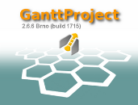

Software
Resources
JAVA EE 1.8
Visual
Paradigm
Eclipse IDE
Wampp server and Mysql
Git
Gantt Project

Slide 8

Hardware
Resources
Laptop

Slide 9
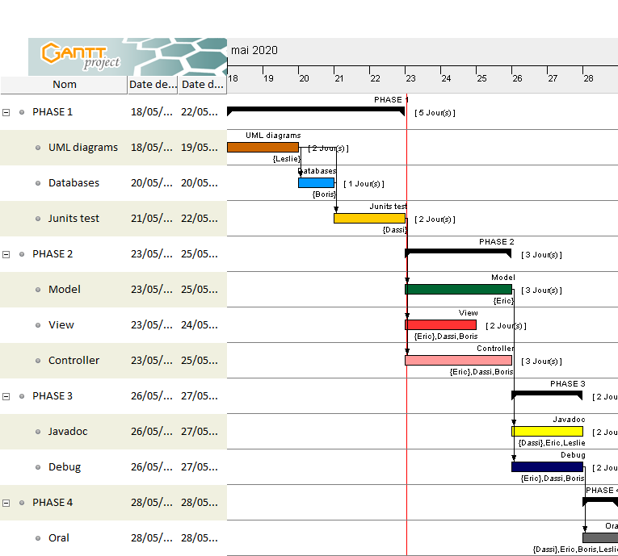
Provisional schedule

Slide 10
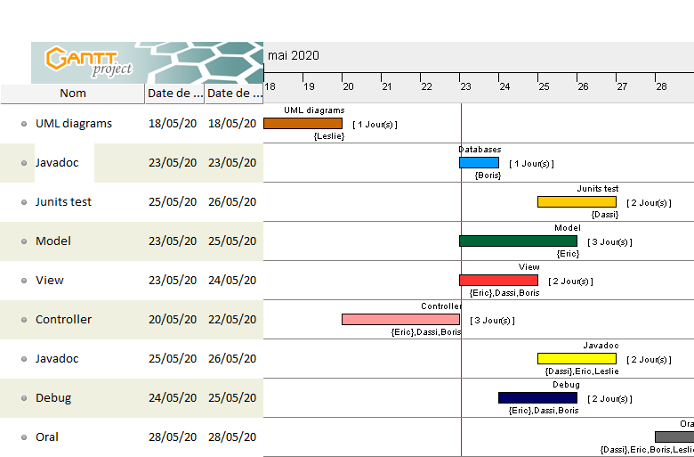
Real schedule

Slide 11
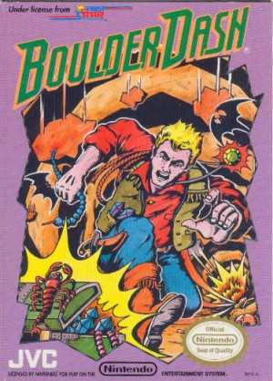
BOULDER DASH
The original Boulder Dash® is a pioneering interactive game dating back to the early times of the home computer and video game era being first launched in 1984. Boulder Dash® and its many sequels have delighted and challenged casual and hard-core players of all ages and sexes for over three decades.

Slide 12
STRUCTURING
AND PRODUCTION
JAVA MODELLING
DATABASE MODELLING
PRODUCTION
MVC

Slide 13
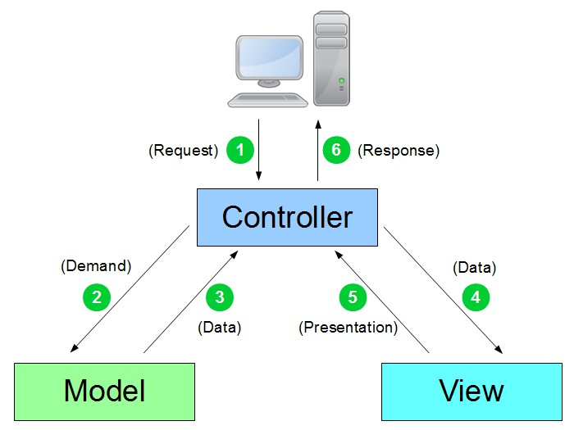
JAVA MODELLING
MVC STRUCTURE

Slide 14
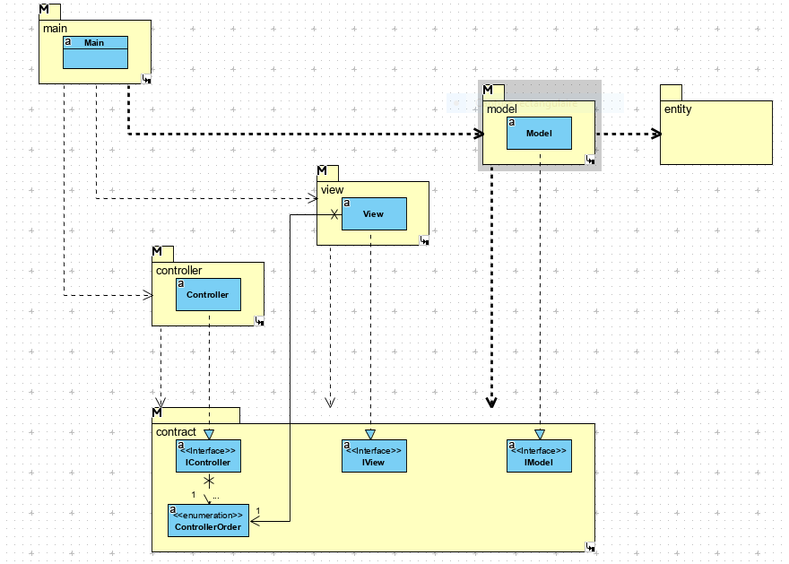
JAVA MODELLING
Diagram of Package

Slide 15
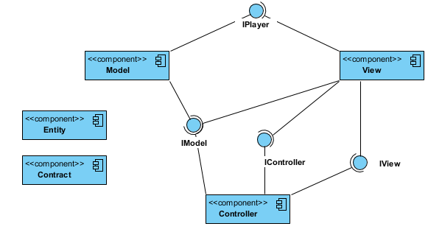
JAVA MODELLING
Component diagram

Slide 16
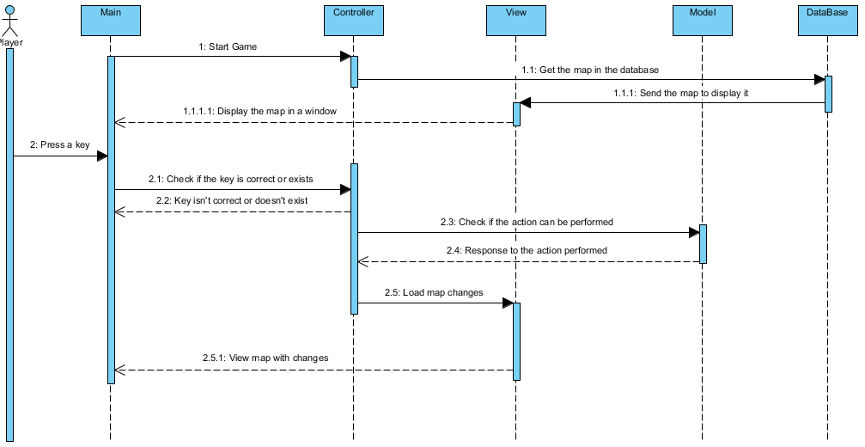
JAVA MODELLING
Sequence diagram

Slide 17
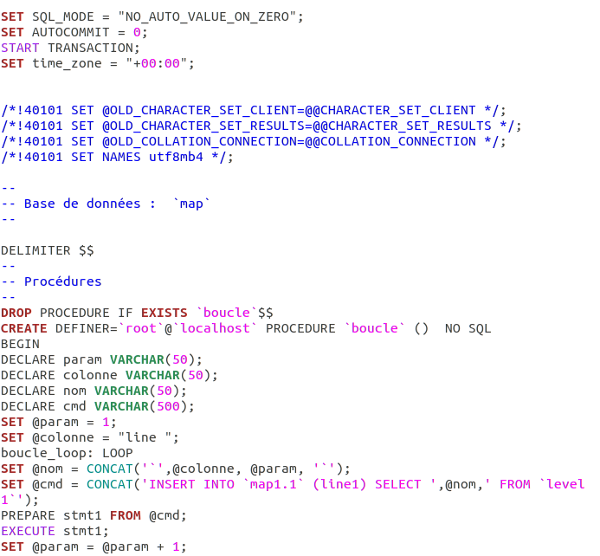
DATABASE MODELLING

Slide 18
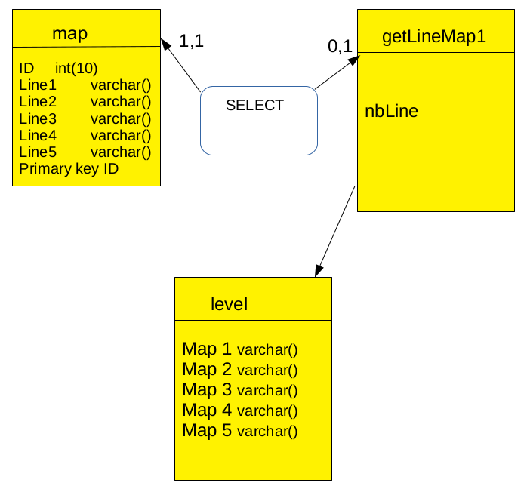
DATABASE MODELLING

Slide 19
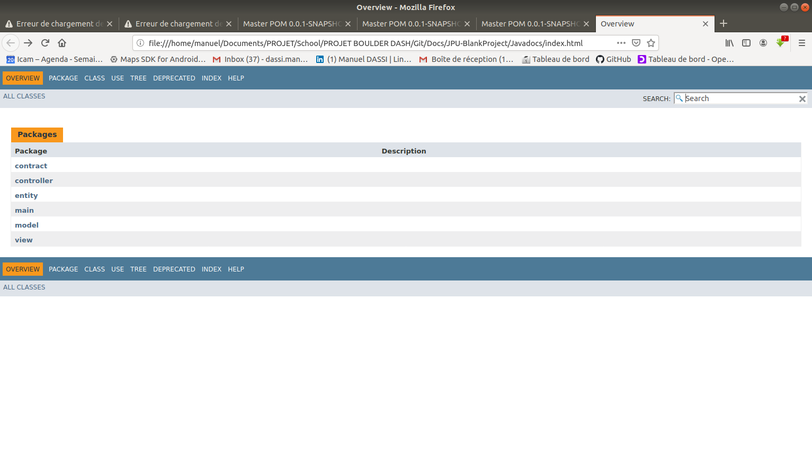
JAVADOC + RAPPORT
SURE FIRE / XREF
JAVA DOCS
COMPLETE
Generate a Java docs of our project

Slide 20
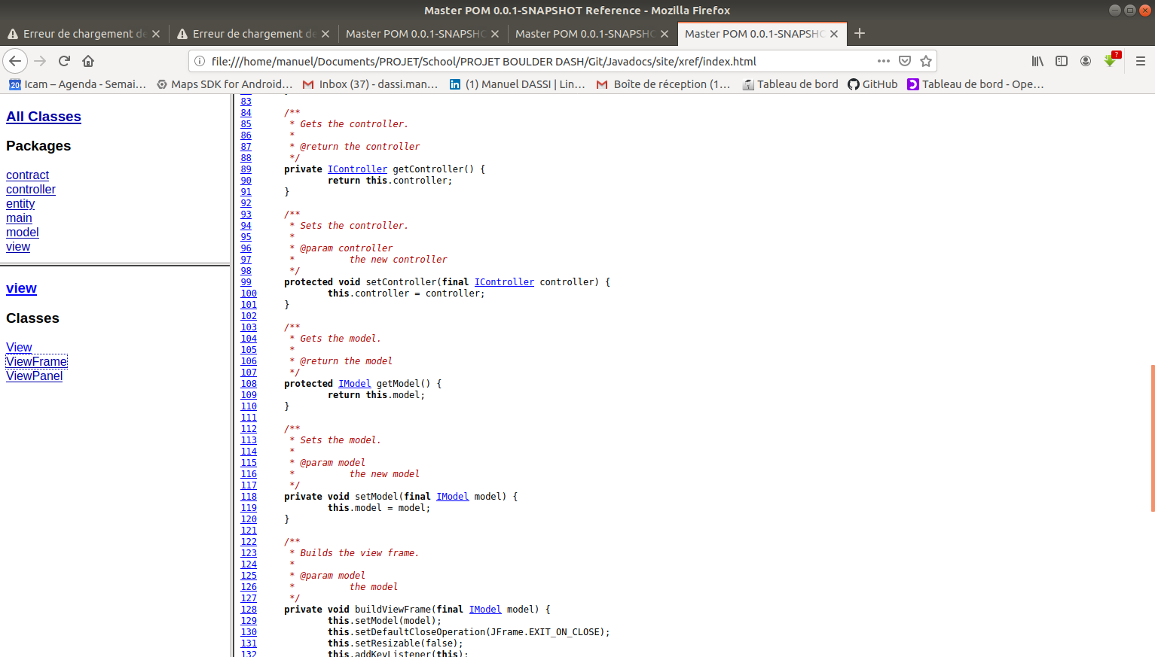
JAVADOC + RAPPORT
SURE FIRE / XREF
RAPPORT
XREF
Generate a Java docs of our project

Slide 21
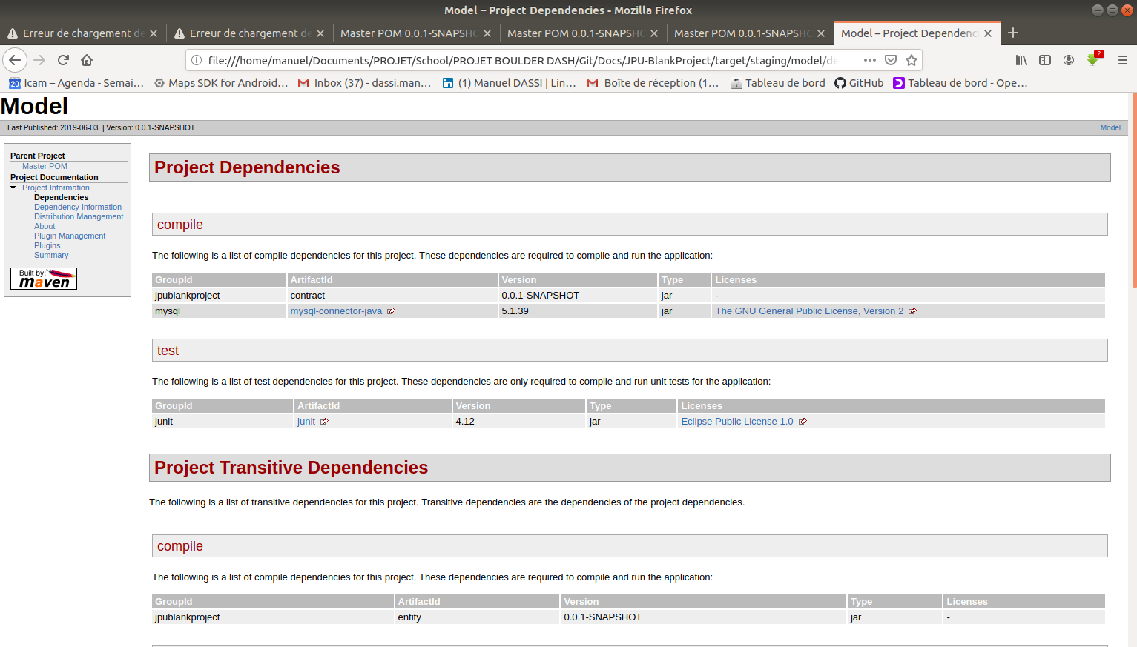
JAVADOC + RAPPORT
SURE FIRE / XREF
RAPPORT
SURE FIRE
Generate a Java docs of our project

Slide 22
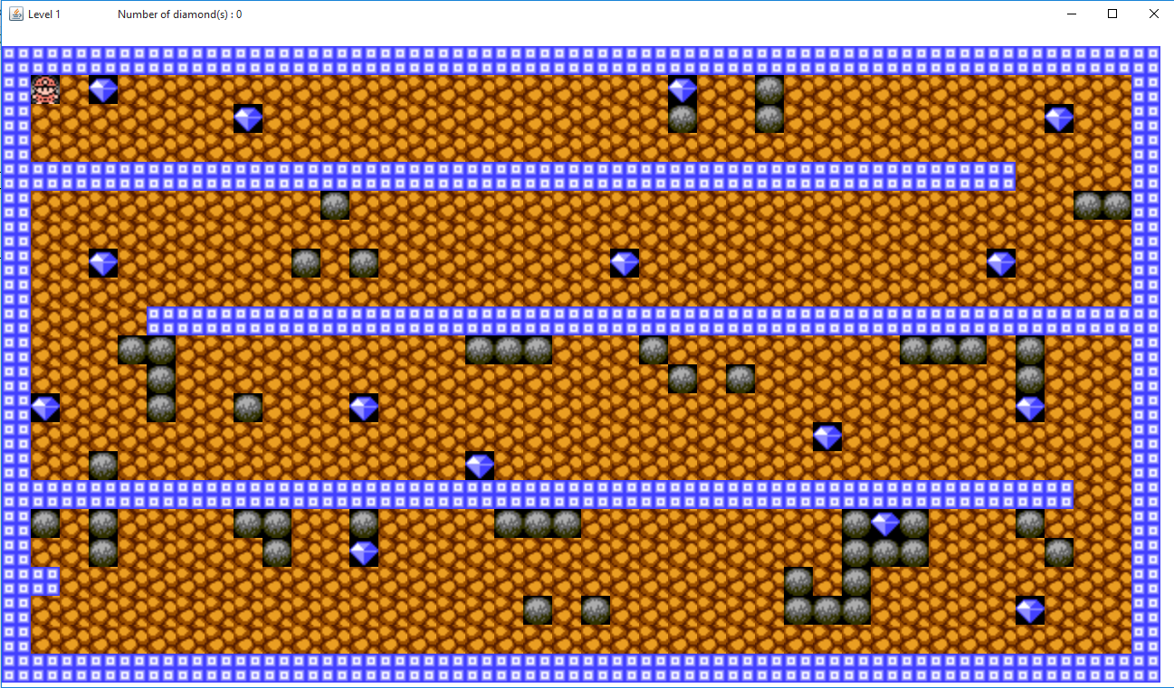
PRODUCTION

Slide 23
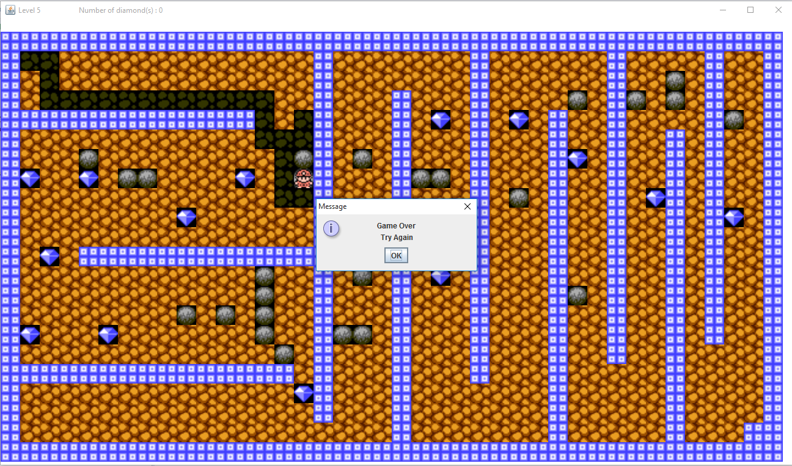
PRODUCTION

Slide 24
CONCLUSION
We had a lot of difficulties during this project and we couldn’t implement all the features we wanted and we couldn’t fix all the bugs. There are a lot of ways to improve !

Slide 25

THANKS

Slide 26
AVIS DES JURY

